Slide 1
Cyber Scam Awareness

Slide 2
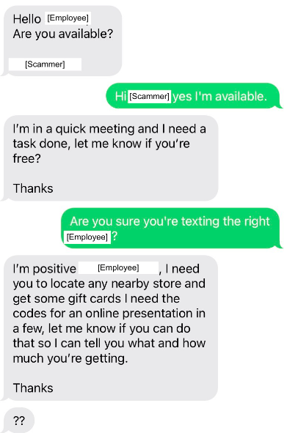
“Do me a Favor”
Most of us are very familiar with this one.
Email from our priest or a deacon or even the Bishop asking us for a favor but they can’t receive any phone calls right now because they are going into a meeting or prayer session
Usually asking for gift cards

Slide 3
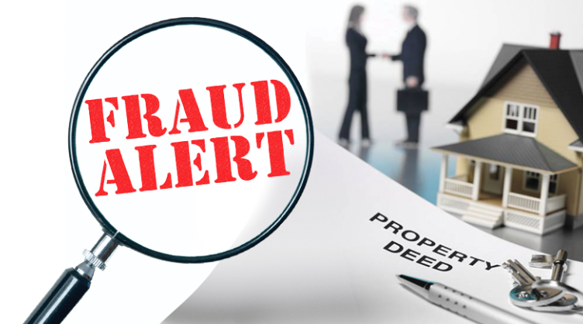
Mortgage and Deed Fraud
We all know about typical “thefts”
Deed forging
False Deed Transfers

Slide 4
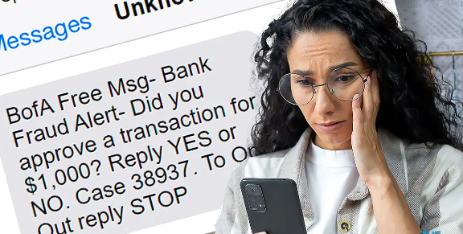
Bank Impersonation
Receiving emails, texts or phone calls from a bank advising an account is locked because of unusual activity
Asks the user to click a links or call a number to verify a transaction.

Slide 5
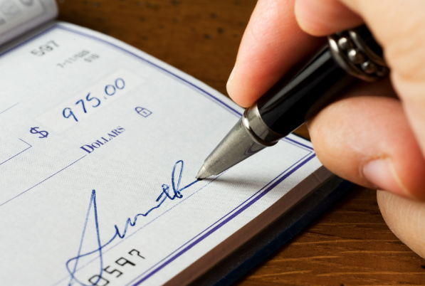
Paper Check Fraud
Limit the use of paper checks
Mail Theft on the Rise
Use Alternative ways of Payment

Slide 6
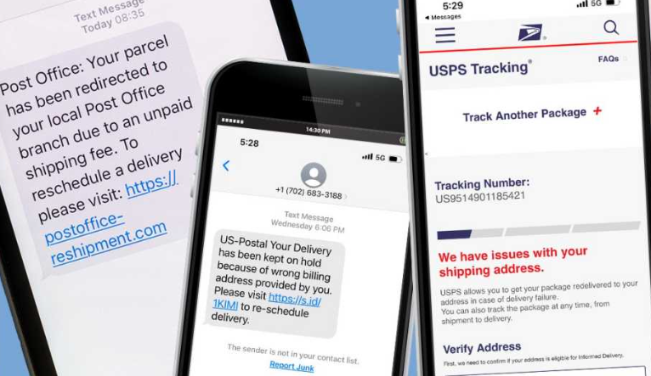
Fake Delivery Service Texts
Criminals pretend to be USPS, FedEx and UPS, smishing for your personal info and money.
Create the idea that you have to deal with it now.

Slide 7
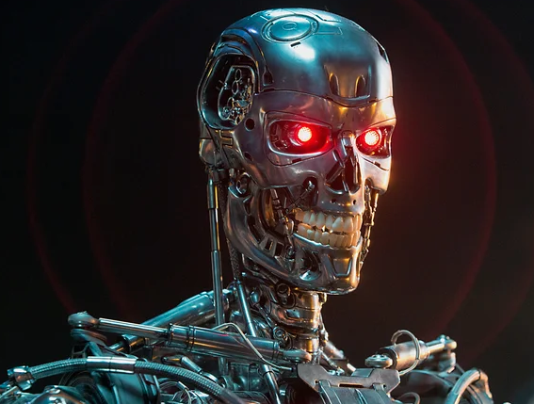
AI Powered Scams
Voice Cloning
Deep Fake Videos

Slide 8
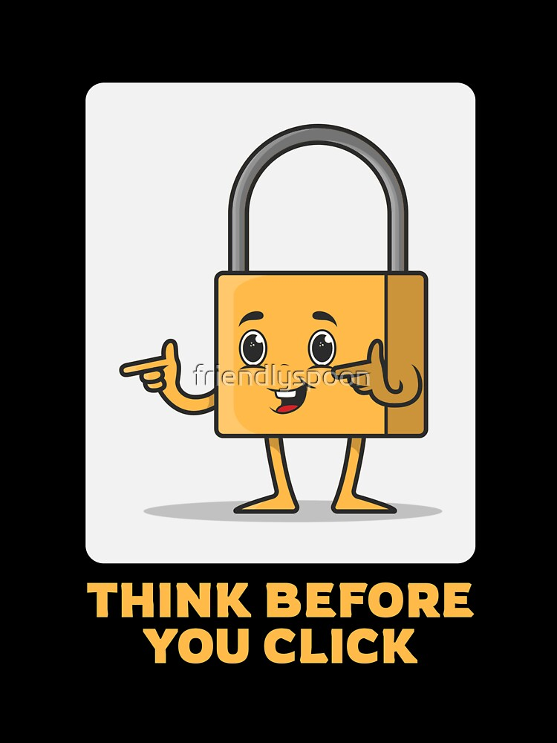
Thank You!

